Slide 1
Multi-Tier Architecture
System Design Fundamentals - Architectural Patterns

Slide 2
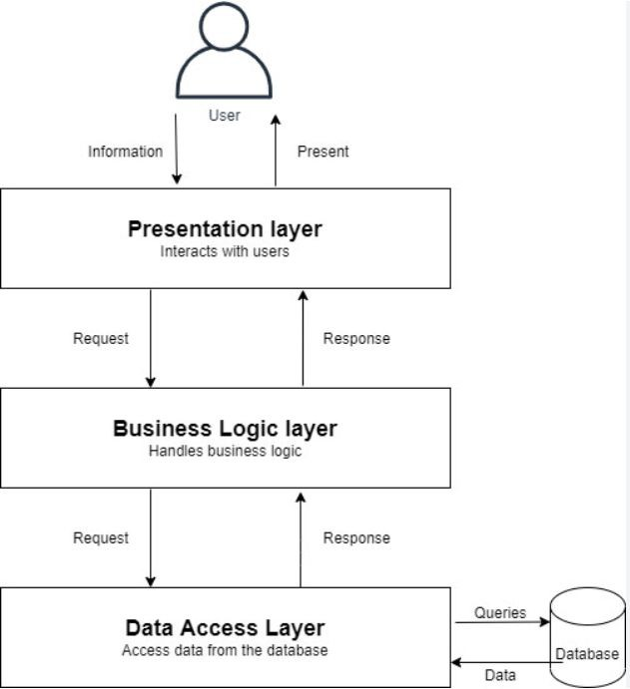
What is Multi-Tier Architecture?
Multi-Tier Architecture is a software design pattern that structures applications into multiple layers, each responsible for speciﬁc functions. This separation enhances scalability, maintainability, and security.
Key Points:
  Organizes applications into independent layers
  Separates concerns: UI, business logic, and data storage
  Enables better scalability, performance, and security
  Used in web applications, enterprise systems, and cloud architectures

Slide 3
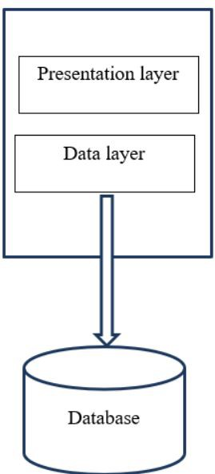





2-Tier Architecture
Deﬁnition: The 2-Tier Architecture consists of a Client Layer and a Database Layer. The client interacts directly with the database, without an intermediate business logic layer.
How It Works:
  Client Layer: User interface, application logic
  Database Layer: Stores and retrieves data
  Data ﬂows directly between the client and the database
Pros:
●
Simple to implement
Fast for small-scale applications
Cons:
  Poor scalability (limited to a few users)
  Security risks (direct database access)
Example Use Case:
●
A desktop application directly querying an SQL database

Slide 4

3-Tier Architecture
Deﬁnition: 3-Tier Architecture introduces a middle layer (Business Logic Layer) between the UI and the database.
How it works:
  The frontend interacts with the business logic layer (API Server).
  The business logic layer processes requests and
communicates with the database.
Pros:
  Improves scalability & security.
  Better separation of concerns.
  Easier maintenance.
Cons:
  Slightly higher latency due to extra processing.
Example:
  Traditional web applications

Slide 5
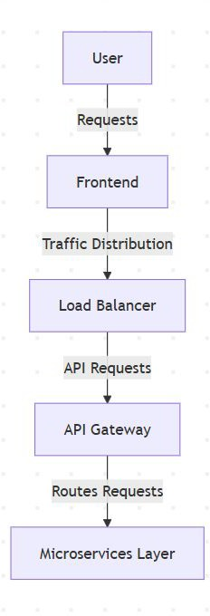
N-Tier Architecture
Deﬁnition: N-Tier Architecture extends beyond 3-Tier by adding more specialized layers like caching, API gateway, microservices, etc.
Why use N-Tier?
  Handles high-traﬃc & complex business logic.
  Allows independent scaling of diﬀerent services.
Examples:
  Microservices-based applications.
  Large-scale enterprise software.

Slide 6
Performance & Scalability Impacts
How tiers impact system performance & scalability:
  Latency Considerations:
    More layers = higher latency if not optimized.
    Solution: Caching (Redis, Memcached), Load Balancing.
  Scaling Strategies:
    Vertical Scaling (adding resources to a single server).
    Horizontal Scaling (adding more servers, distributing load).

Slide 7
Interview Questions
Basic Questions:
  What is Multi-Tier Architecture, and why is it used?
  How does a 2-Tier architecture diﬀer from a 3-Tier architecture?
  What are the key components of a 3-Tier architecture?
  Can you give an example of a real-world application that follows an N-Tier architecture?
Intermediate Questions:
  How does scalability improve in a multi-tier system?
  What are the challenges of adding more tiers in an application?
  How does load balancing work in an N-Tier architecture?
  What strategies can be used to reduce latency in a multi-tier application?
Advanced Questions:
  In a large-scale system, when would you choose microservices over a traditional N-Tier architecture?
  How would you secure inter-tier communication in a distributed multi-tier system?
  How would you design a fault-tolerant multi-tier system for a high-traﬃc application like Netﬂix or Amazon?

Slide 8
Summary & Key Takeaways
Multi-Tier = Better Scalability & Maintainability.
2-Tier is simple but limited.
3-Tier is the standard for web apps.
N-Tier is for large-scale, cloud-native systems.
What’s Next:
  Microservices Architecture

